Slide 1


Artificial Intelligence For CBSE Teachers
Workshop Under
AICTE Training and Learning Program (ATAL) Initiative
Organized by:
The LNMIIT Centre for Smart Technologies
7th to 11th June 2021

Slide 2
Part – B Data Science Class X

Slide 3
Data Science (Class X)
Introduction to Data Science
Applications
Revisit AI Project Cycle
Data Collection
Python for Data Science
Statistical Learning and Data Visualization
KNN Algorithm

Slide 4
Introduction to Data Science

Slide 5

A game (Rock paper scissors)
https://www.afiniti.com/corporate/rock-paper-scissors

Slide 6
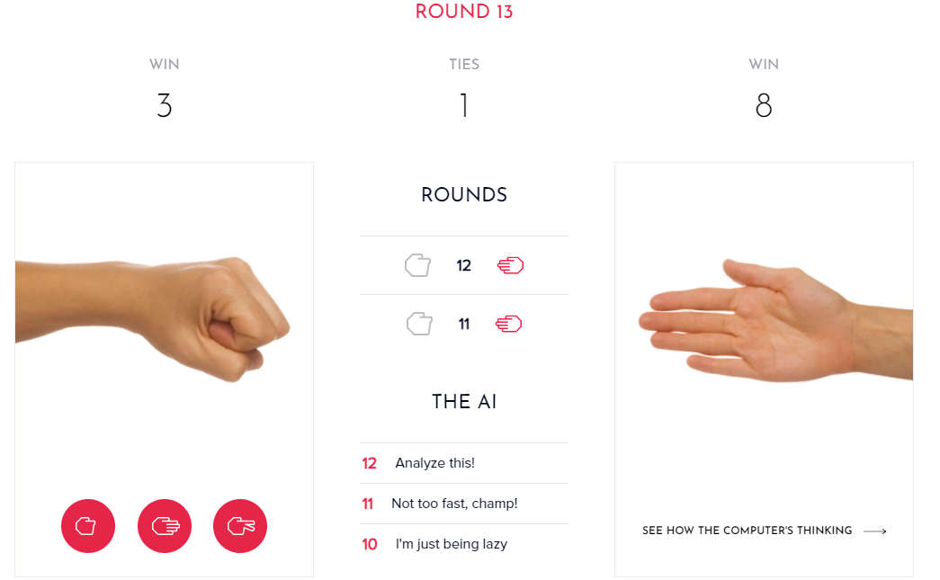

Slide 7
What is data science
Data Science is a blend of various tools, algorithms, and machine learning principles with the goal to discover hidden patterns from the raw data.
It not only explains the data but also predicts from the same.
Data Analyst usually explains what is going on by processing history of the data
Mathematics
Statistical Research
Machine Learning
Domain
Expert
Computer
Science
Data Science
Data Processing

Slide 8
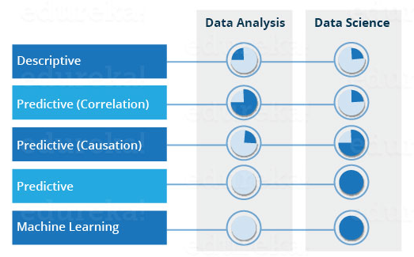
Data analysis vs Data Science

Slide 9
Why Data Science?
Traditionally the data was structured and analysis was comparatively easy.
Now, more than 80% of the data is unstructured and traditional methods cannot work on such data
Also, very specific requirements from the customer about existing data raises the demand for data science.

Slide 10
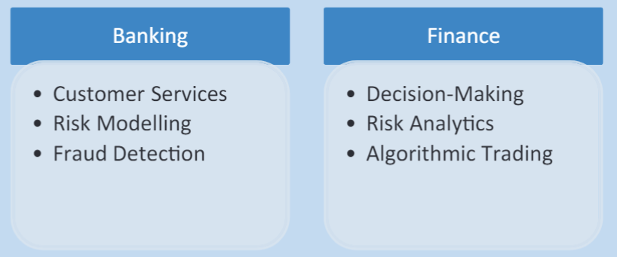
Applications of Data Science

Slide 11
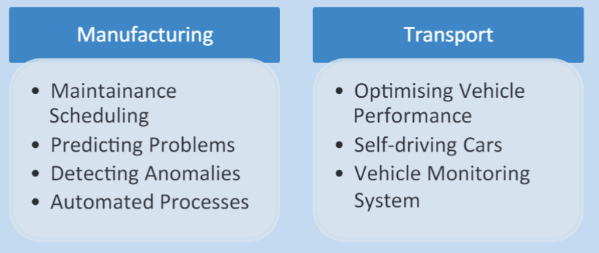
Applications of Data Science

Slide 12
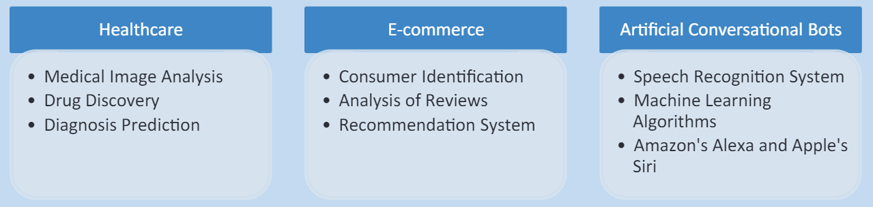
Applications of Data Science

Slide 13
Revision AI project Cycle An Example with Data Science

Slide 14
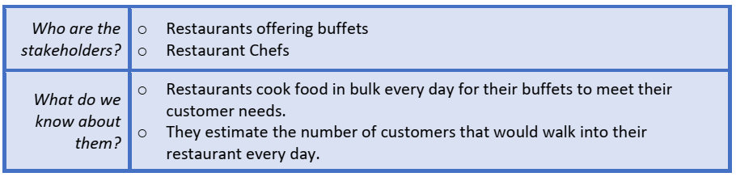
Problem Scoping
Who?

Slide 15
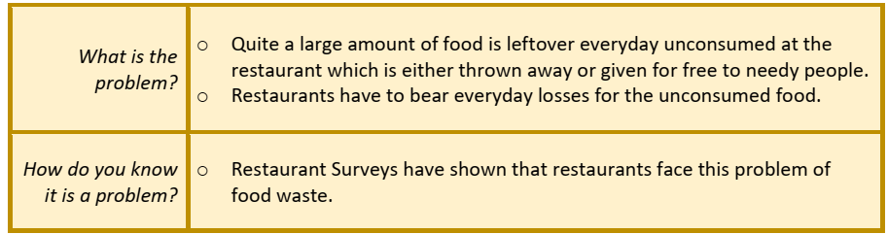
What?

Slide 16
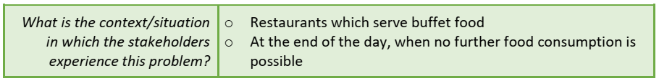
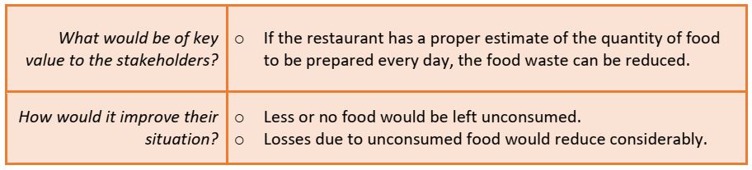
Where?
Why?

Slide 17
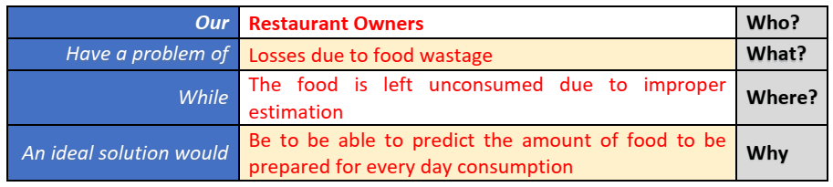
Problem Statement

Slide 18
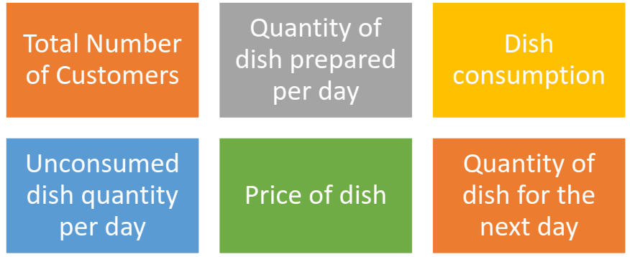
Data Acquisition

Slide 19
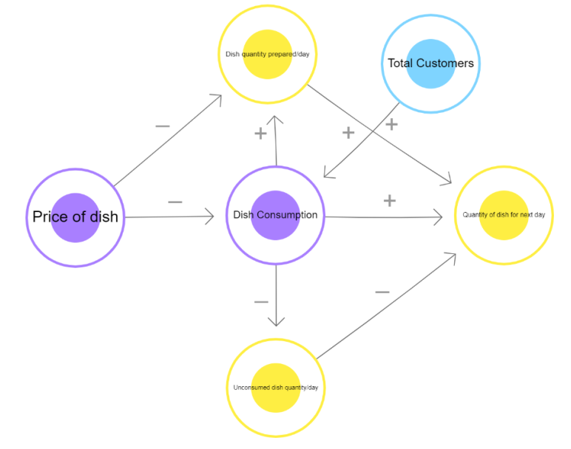
Data mapping
Connect them to make a decision tree
Elements:
Dish Quantity
Dish Price
Total Customers
Dish consumption
Quantity for next day
Unconsumed dish quantity

Slide 20
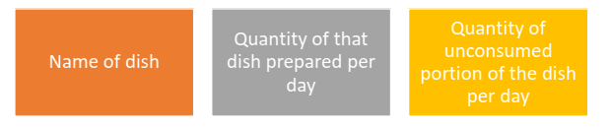
Data Exploration
After creating the database, we now need to look at the data collected and understand what is required out of it.
In this case, since the goal of our project is to be able to predict the quantity of food to be prepared for the next day, we need to have the following data:

Slide 21
Modeling
A regression model is chosen in which the dataset is fed as a dataframe and is trained accordingly.
Since in our case the data which we have is a continuous data of 30 days, we can use the regression model so that it predicts the next values to it in a similar manner.
In this case, the dataset of 30 days is divided in a ratio of 2:1 for training and testing respectively.
In this case, the model is first trained on the 20-day data and then gets evaluated for the rest of the 10 days.

Slide 22
Evaluation
Once the model has been trained on the training dataset of 20 days, it is now time to see if the model is working properly or not
Step 1: The trained model is fed data regards the name of the dish and the quantity produced for the same. Step 2: It is then fed data regards the quantity of food left unconsumed for the same dish on previous occasions.
Step 3: The model then works upon the entries according to the training it got at the modelling stage.
Step 4: The Model predicts the quantity of food to be prepared for the next day.

Slide 23
Step 5: The prediction is compared to the testing dataset value. From the testing dataset, ideally, we can say that the quantity of food to be produced for next day’s consumption should be the total quantity minus the unconsumed quantity. Step 6: The model is tested for 10 testing datasets kept aside while training. Step 7: Prediction values of testing dataset is compared to the actual values. Step 8: If the prediction value is same or almost similar to the actual values, the model is said to be accurate. Otherwise, either the model selection is changed or the model is trained on more data for better accuracy.

Slide 24
Data Collection

Slide 25
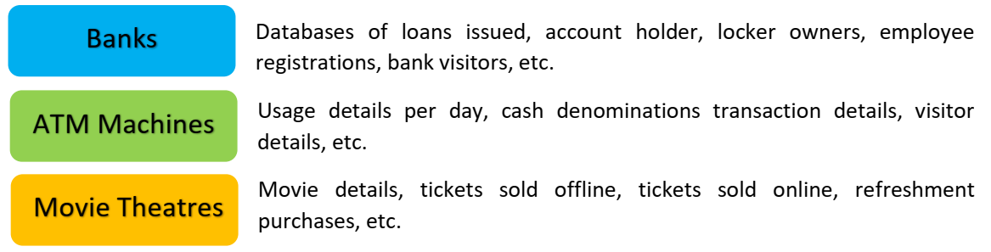

Commonly used datasets

Slide 26
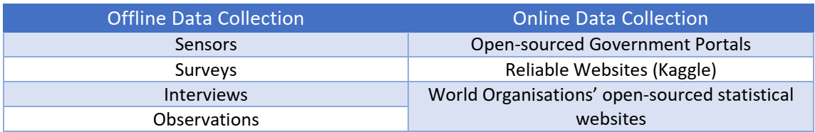
Sources of data

Slide 27
Statistics with Python

Slide 28
Commonly used Statistical functions
Function | Description
Mean | The average value of the sequence
Median | 50th percentile (central value) of a sorted sequence.
Mode | Most frequent value of a sequence
Standard Deviation | Measures the spread of the sequence around the mean value
Variance | Average of squared differences from the mean

Slide 29
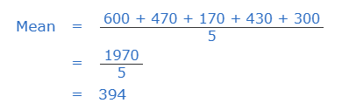
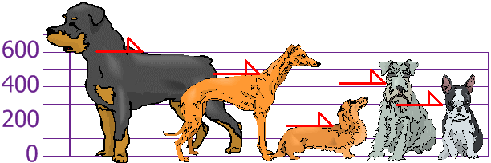
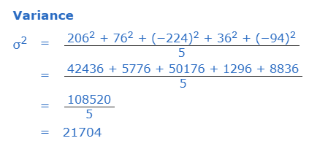
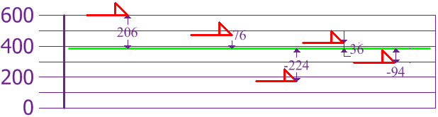
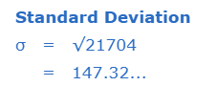
Example

Slide 30
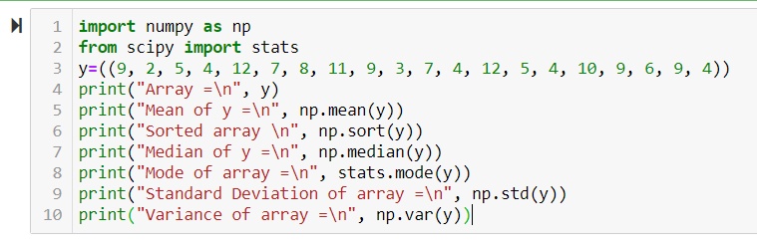
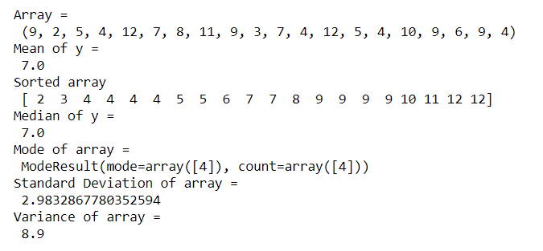
Code

Slide 31
Issues with data
Erroneous Data:
Incorrect values: The values in the dataset (at random places) are incorrect.
Invalid or Null values: At some places, the values get corrupted and hence they become invalid.
Missing Data: In some datasets, some cells remain empty
Outliers: Data which does not fall in the range of a certain element are referred to as outliers.

Slide 32
Types of plots (covered in Advanced Python)
Scatter plot
Bar Chart
Histogram
Pie Charts
Box Plot

Slide 33
KNN Algorithm

Slide 34
KNN Algorithm
The k-nearest neighbours (KNN) algorithm is a simple, easy-to-implement supervised machine learning algorithm that can be used to solve both classification and regression problems.
The KNN algorithm assumes that similar things exist in close proximity.
Some features of KNN are:
The KNN prediction model relies on the surrounding points or neighbours to determine its class or group
Utilises the properties of the majority of the nearest points to decide how to classify unknown points
Based on the concept that similar data points should be close to each other

Slide 35
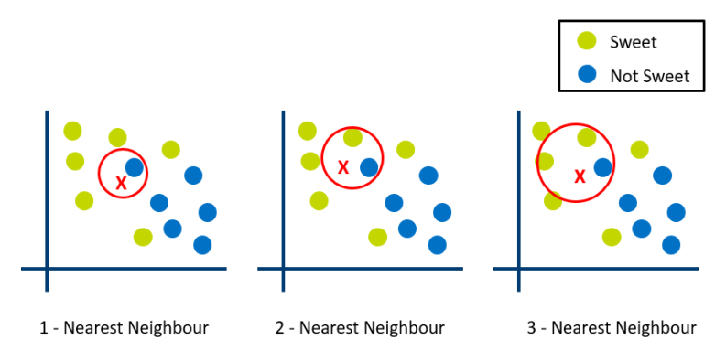
Graphical example

Slide 36
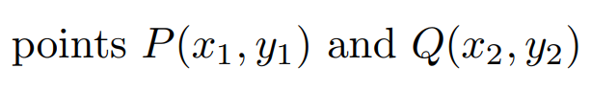
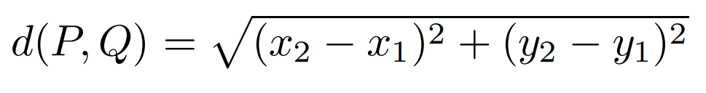
Euclidian distance
Euclidian distance between two points on a 2-D plane is

Slide 37
Example: Size of T shirt
Height (in cms) | Weight (in kgs) | T Shirt Size
158 | 58 | M
158 | 59 | M
158 | 63 | M
160 | 59 | M
160 | 60 | M
160 | 64 | L
163 | 60 | M
163 | 61 | M
163 | 64 | L
165 | 61 | L
165 | 62 | L
165 | 65 | L
168 | 62 | L
168 | 63 | L
168 | 66 | L
170 | 63 | L
170 | 64 | L
170 | 68 | L
Consider the dataset.
A person’s height and weight can decide the size of T shirt.
Now decide what will be size for a person with height = 162cm and weight = 60kg

Slide 38
Find Distances
Height (in cms) | Weight (in kgs) | T Shirt Size | Distance
158 | 58 | M | 4.472135955
158 | 59 | M | 4.123105626
158 | 63 | M | 5
160 | 59 | M | 2.236067977
160 | 60 | M | 2
160 | 64 | L | 4.472135955
163 | 60 | M | 1
163 | 61 | M | 1.414213562
163 | 64 | L | 4.123105626
165 | 61 | L | 3.16227766
165 | 62 | L | 3.605551275
165 | 65 | L | 5.830951895
168 | 62 | L | 6.32455532
168 | 63 | L | 6.708203932
168 | 66 | L | 8.485281374
170 | 63 | L | 8.544003745
170 | 64 | L | 8.94427191
170 | 68 | L | 11.3137085
We got the Euclidian distances for each entry with respect to 162,60

Slide 39
Give Ranks
Height (in cms) | Weight (in kgs) | T Shirt Size | Distance | Rank
163 | 60 | M | 1 | 1
163 | 61 | M | 1.414213562 | 2
160 | 60 | M | 2 | 3
160 | 59 | M | 2.236067977 | 4
165 | 61 | L | 3.16227766 | 5
165 | 62 | L | 3.605551275 | 6
158 | 59 | M | 4.123105626 | 7
163 | 64 | L | 4.123105626 | 8
158 | 58 | M | 4.472135955 | 9
160 | 64 | L | 4.472135955 | 10
158 | 63 | M | 5 | 11
165 | 65 | L | 5.830951895 | 12
168 | 62 | L | 6.32455532 | 13
168 | 63 | L | 6.708203932 | 1
168 | 66 | L | 8.485281374 | 15
170 | 63 | L | 8.544003745 | 16
170 | 64 | L | 8.94427191 | 17
170 | 68 | L | 11.3137085 | 18
Now we can see that if we select K = 1, 2, 3, 4 then all the neighbors are M.
Even upto 10, the majority is M.

